Slide 1
Office 365 Development

Slide 2
Course Agenda
Deep Dive into the Building Blocks and Services of the SharePoint Platform
Module 1: Developing Advanced Workflow Scenarios in Office 365
Module 2: Deep Dive into SharePoint Lists for Data Storage
Module 3: Deep Dive into SharePoint Lists with REST APIs
Module 4: Deep Dive into SharePoint Lists with CSOM APIs
Module 5: SharePoint 2013 Remote Event Receivers
Module 6: Deep Dive into Search Scenarios in Office 365
Module 7: Deep Dive into Business Connectivity Services in Office 365
Module 8: Developing Advanced Taxonomy Scenarios in Office 365

Slide 3
O3656-7 Deep Dive into Business Connectivity Services in Office 365
Speaker
Speaker

Slide 4

Agenda
Overview
App-Level External Content Types
Hybrid Business Connectivity Services
Custom Event Receivers

Slide 5
Overview

Slide 6
Business Connectivity Services
Supports the integration of data into SharePoint through an object relational map (ORM) known as an External Content Type (ECT)
ECTs are built against SQL Azure or OData sources
ECTs define the fields and operations to integrate

Slide 7
Secure Store Service
Credential Mapping System
Allows for the definition of a service account for accessing External System.

Slide 8
Development Tasks
Creating ECTs in SharePoint Designer or Visual Studio
Importing ECTs into Business Connectivity Services
Configuring the Secure Store
Creating External Lists
Creating Apps

Slide 9
App-Level ECTs

Slide 10
App-Level ECTs
Ability to define ECT within an app
ECT is isolated to the app only
Can be used to create External List
Can be access using API

Slide 11
Architecture
External Content Type
FileBackedMetadataCatalog (BDC Runtime Components)
OData Source
External List

Slide 12
External List Definitions
<?xml version="1.0" encoding="utf-8"?>
<Elements xmlns="http://schemas.microsoft.com/sharepoint/">
<ListInstance Url="Lists/Employees" Description="Employees"
OnQuickLaunch="TRUE" Title="Employees">
<DataSource>
<Property Name="LobSystemInstance" Value="Northwind" />
<Property Name="EntityNamespace" Value="NorthwindModel" />
<Property Name="Entity" Value="Employees" />
<Property Name="SpecificFinder" Value="ReadSpecificEmployee" />
<Property Name="MetadataCatalogFileName" Value="BDCMetadata.bdcm" />
</DataSource>
</ListInstance>
</Elements>

Slide 13
CSOM Against External List
using (var clientContext = spContext.CreateUserClientContextForSPAppWeb()) {
List list = clientContext.Web.Lists.GetByTitle("Employees");
CamlQuery camlQuery = new CamlQuery();
camlQuery.ViewXml = @"<View>...";
ListItemCollection listItems = list.GetItems(camlQuery);
clientContext.Load(
listItems,
items => items
.Include(
item => item["EmployeeID"],
item => item["LastName"],
item => item["FirstName"],
item => item["HireDate"],
item => item["HomePhone"]));
clientContext.ExecuteQuery();
foreach (ListItem listItem in listItems) {
…
}

Slide 14
demo
App-Level ECTs

Slide 15
Hybrid Business Connectivity Services

Slide 16
SharePoint Hybrid
Mutual Trust between SharePoint Online and On-Premises
Common Identity Management
Topologies
One-Way Inbound
One-Way Outbound
Two-Way
Notes:
Office 365 and SharePoint Online
O365 – Every Microsoft Office 365 subscription hosts a SharePoint Online tenancy. The O365 subscription also provides the Access Control Service (ACS) and Microsoft Online Directory Services (MSODS).
SharePoint Online – Hosts the sites that surface the on-premises LOB data, the BCS runtime service and metadata store, and the Secure Store Service.
BCS Runtime Service Online - The BCS runtime service is a SharePoint service application that manages all BCS functionality, such as administration, security, and communications.
O365 Microsoft Online Directory Services (MSODS) – Provides directory services in O365 that you can synchronize with your on-premises Active Directory Domain Services (AD DS). The synchronization is done through user profile synchronization and allows users to use the same account for both on-premises and cloud authentication.
SharePoint Online Secure Store Service – This is the credential mapping SharePoint service application. In the SharePoint BCS Hybrid solution, SharePoint Online stores an SSL Server certificate that authenticates the SharePoint Online request to the reverse proxy.
Azure Access Control Service – This the Azure security token service that performs authentication and issues security tokens when a user logs in to a SharePoint Online site.
It looks up credentials in the MSODS, which has been synchronized with the on-premises Active Directory accounts. This allows the user to use the same set of credentials for both the on-premises and online environments.
On-Premises
Reverse Proxy – This server is responsible for accepting and authenticating inbound traffic from the Internet and publishing out the endpoint for the inbound request to connect to. It is in the perimeter network.
SharePoint On-Premises – A SharePoint 2013 server farm, this hosts the BCS service, the site that accepts the inbound hybrid requests and the Secure Store Service.
AD DS – A Windows Server service that stores and manages user accounts, security groups, distribution groups, and computer accounts.
User Profile Store – A SharePoint database used to store user profile information. User profiles contain detailed information about people in an organization. A user profile organizes and displays all of the properties related to each user, together with social tags, documents, and other items related to that user. In the BCS Hybrid scenario, it is used to map the users ACS OAuth credentials to the users’ domain credentials.
CSOM Pipeline – The Client-Side Object Model receives the incoming request from the reverse proxy and maps the OAuth user token from ACS to the users’ domain credentials.
Site/Site Collection – A site collection created expressly for the purpose of facilitating all hybrid request communication. The web application that this site collection is in has an alternate access mapping configured.
BCS Runtime Service SharePoint On-Premises – The BCS Runtime service is a SharePoint service application that manages all BCS functionality, such as administration, security, and communications.
Secure Store Service SharePoint On-Premises – This is the credential mapping
SharePoint service application. In the SharePoint BCS Hybrid solution, SharePoint OnPremises stores the mapping of the users’ domain credentials to the credentials that are used to access the external data source.
OData Service Head – The SharePoint BCS Hybrid Solution only supports the OData protocol. If your external data is not natively accessible via an OData source, you must use Visual Studio to build and deploy an OData service head for it.
External Data – The line-of-business (LOB) data that the SharePoint BCS Hybrid solution works with.

Slide 17
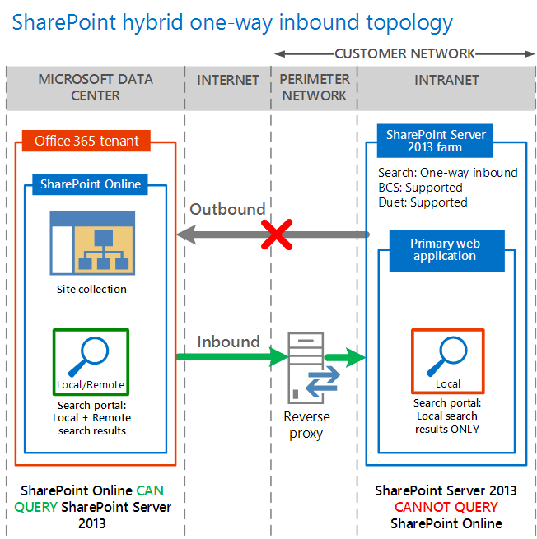
One-Way Inbound
SharePoint Online apps and External Lists can utilize on-premises OData sources
SharePoint Online search can utilize the on-premises search index

Slide 18
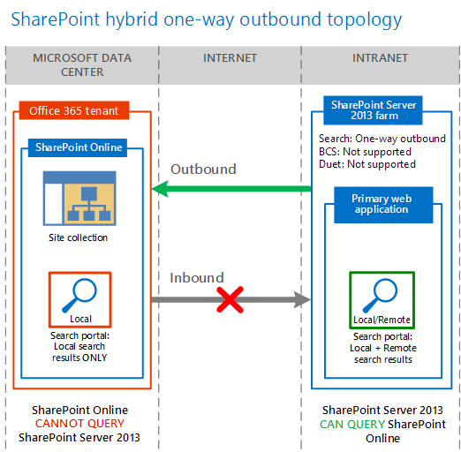
One-Way Outbound
No scenario for BCS
SharePoint on-premises search can utilize the online search index

Slide 19
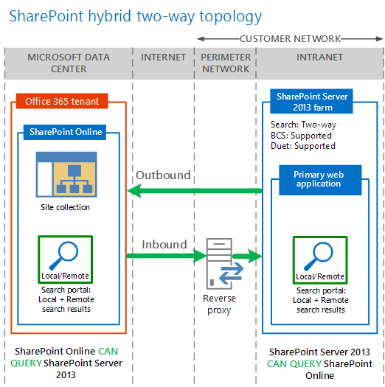
Two-Way
SharePoint Online apps and External Lists can utilize on-premises OData sources
SharePoint Online search can utilize the on-premises search index
SharePoint on-premises search can utilize the online search index

Slide 20
One-Way Inbound BCS
Create on-premises OData source
Expose the OData source via reverse proxy
Create an External Content Type
Configure on-premises Secure Store
Configure online Secure Store
Upload ECT and create External List

Slide 21
Create and Expose OData Source
Create OData source using WebAPI of WCF
Publish this service exposed through reverse proxy and protected by server certificate

Slide 22
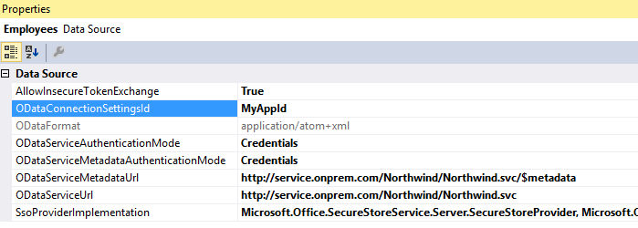
Create an External Content Type
Create in Visual Studio through App project
Modify model to use Secure Store
ODataConnectionStringId is the name of the AppId
ODataServiceAuthenticationMode = Credentials
ODataServiceMetadaAuthenticationMode = Credentials
SSOProviderImplementation = Microsoft.Office.SecureStoreService.Server.SecureStoreProvider, Microsoft.Office.SecureStoreService, Version=14.0.0.0, Culture=neutral, PublicKeyToken=71e9bce111e9429c

Slide 23
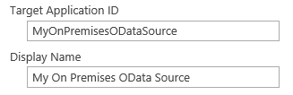
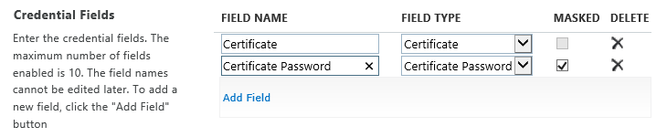
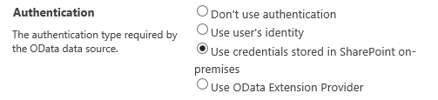
Secure Store
Create an on-premises Secure Store entry with local credentials
Create an online Secure Store entry that uses certificate credentials
Create an online connection entry to on-premises
Notes:
The BCS hybrid solution is a combination of the SharePoint Hybrid configuration and a BCS configuration. Each configuration requires different sets of certificates and user credentials and you need both sets in order for the BCS Hybrid solution to work.
Server and SharePoint Certificates
SSL certificate - This certificate is used to establish trust for the communication channel between the reverse proxy device and O365. This can be a wild card certificate; it should be from a well-known certificate authority.
Server to Server – Server-to-Server authentication configuration for SharePoint Hybrid environments consists of establishing a trust between SharePoint on-premises and Access Control Service (ACS). ACS is then the trust broker for both SharePoint on-premises and SharePoint Online server. When Server-to-Server trust is fully configured, each server farm trusts the security tokens that are issued by ACS and are used for authenticating access to resources on behalf of the identified user.
User Credentials
OAuth security token from ACS – When a user logs on to SharePoint Online, the user is authenticated by ACS. ACS issues an OAuth security token, which represents the user to all SharePoint Online processes and objects that the user tries to access. This security token is embedded in the request for external data and passed, along with the SSL certificate, to the reverse proxy. From there, it is passed to the Client-Side Object Model (CSOM) pipeline in SharePoint on-premises and is mapped to the users domain credentials
Users Active Directory credentials – This is another security token that represents the user in the user’s Active Directory domain. It represents the user to all domain resources that the user tries to access. In the SharePoint BCS Hybrid configuration, it is used to authenticate the user to SharePoint on-premises.
External Data Credentials - The OData service is secured by using either basic authentication or Windows authentication, or by using a custom authentication provider.

Slide 24
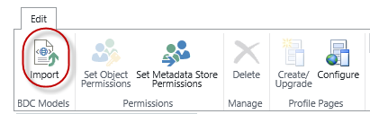
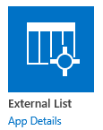
ECT and External List
Upload the ECT and Configure permissions
Create an External List in SharePoint Online

Slide 25

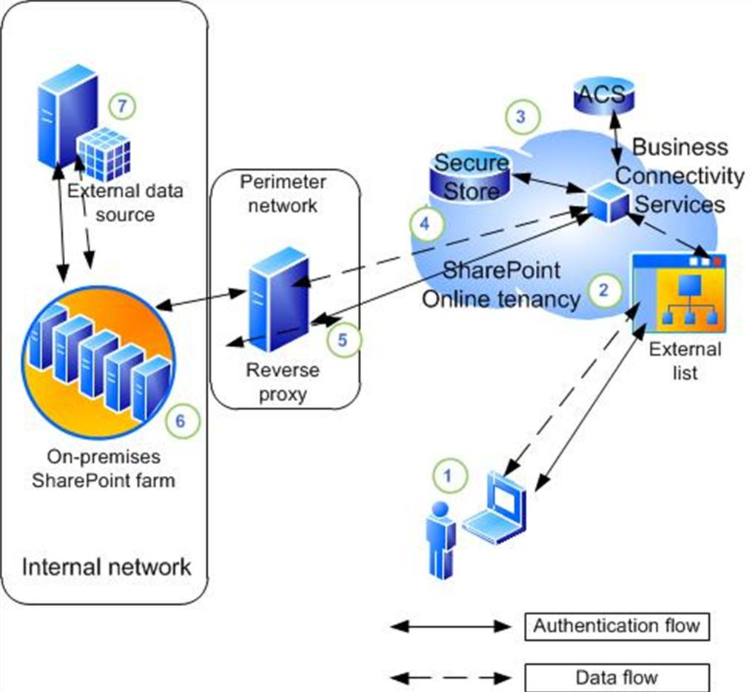
Data Flow
Notes:
An information worker logs on to their SharePoint Online tenancy and opens an external list which requires data from an on-premises OData source.
2. The external list creates a request for the data and sends it to Business Connectivity Services. BCS looks at the request and refers to the external content type and the connection settings object to see how to connect to the data source and which credentials to use.
3. Business Connectivity Services retrieves a client certificate from the Secure Store service in SharePoint Online. The client certificate is an SSL certificate and it is used for authentication to the reverse proxy. BCS also retrieves an OAuth token form the Access Control Service. These are the uses credentials which are used for user authentication to the SharePoint 2013 on-premises farm.
4. The Business Connectivity Service sends a HTTPS request to the endpoint for the data source that is published by the reverse proxy.
5. The reverse proxy authenticates the request by using the client certificate and forwards it to the Client Side Object Model (CSOM) pipeline of the on-premises SharePoint 2013 farm.
6. The CSOM pipeline consults the User Profile Service to look for a mapping between the users OAuth security token from ACS and the user’s domain credentials from AD DS. If one exists, the user’s domain credentials are returned to the request. The user’s domain credentials are used to authenticate to the SharePoint on-premises Site that receives Hybrid requests and the request is passed to the SharePoint On-Premises BCS service.
7. The SharePoint On-Premises BCS retrieves the credentials that are used to authenticate to the external data source from the SharePoint On-Premises Secure Store Service. Then SharePoint on-premises BCS service passes the request for data along with the external data credentials to the OData service head which then performs the desired operations on the external data and returns the results to the SharePoint Online user.

Slide 26
Custom Event Receivers

Slide 27
Custom Event Receivers
Supported Scenarios
External List Event Handlers
ECT Event Handlers
External List Alerts
Supported Events
Item Added
Item Updated
Item Deleted

Slide 28
Design Requirements
ECT must implement special stereotypes
Subscribe (DeliveryAddress, EventType)
Unsubscribe (SubscriptionId)
SharePoint creates delivery address
External system calls on delivery address in response to an event

Slide 29
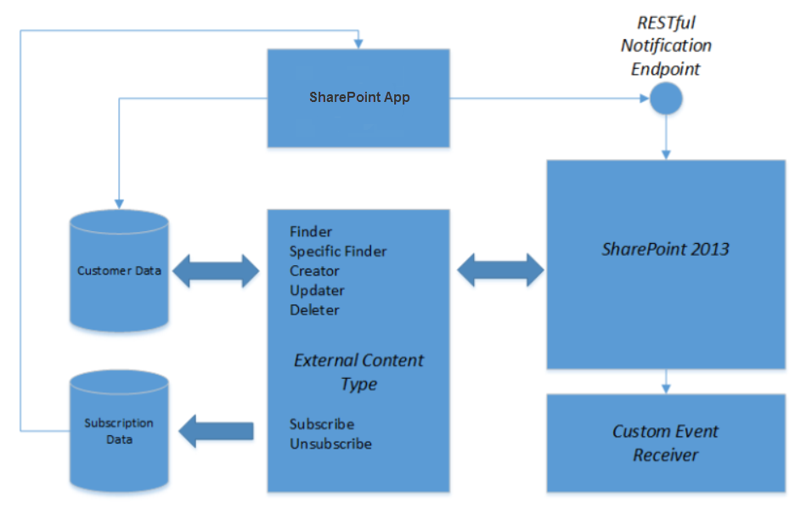
Architecture

Slide 30
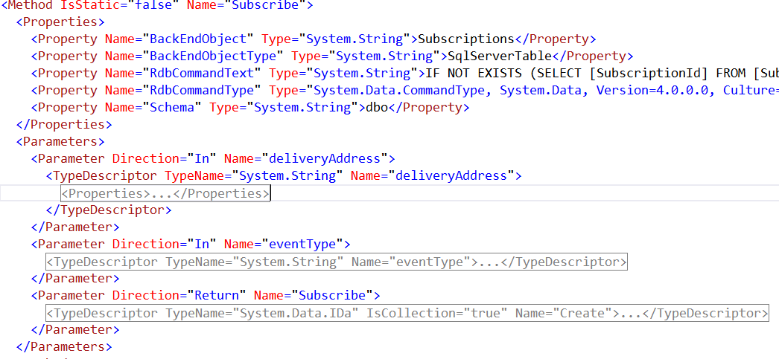
Subscribe

Slide 31
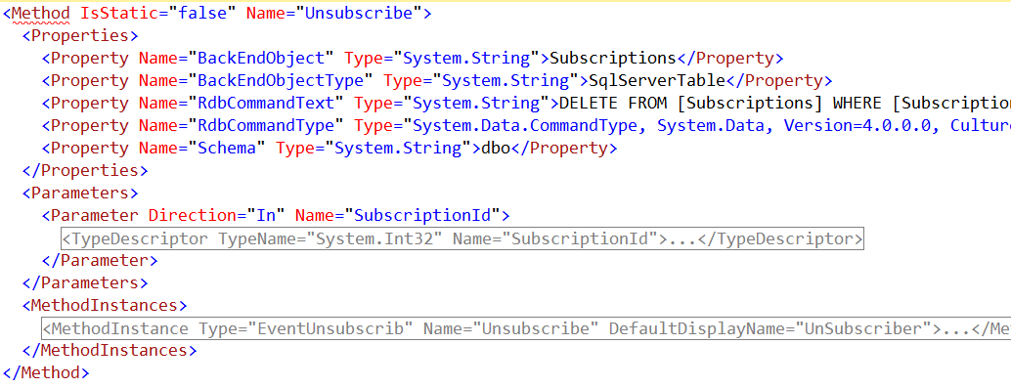
Unsubscribe

Slide 32
demo
Custom Event Receivers

Slide 33
Summary
Overview
App-Level External Content Types
Hybrid Business Connectivity Services
Custom Event Receivers

Slide 34

© 2012 Microsoft Corporation. All rights reserved. Microsoft, Windows, and other product names are or may be registered trademarks and/or trademarks in the U.S. and/or other countries.
The information herein is for informational purposes only and represents the current view of Microsoft Corporation as of the date of this presentation. Because Microsoft must respond to changing market conditions, it should not be interpreted to be a commitment on the part of Microsoft, and Microsoft cannot guarantee the accuracy of any information provided after the date of this presentation. MICROSOFT MAKES NO WARRANTIES, EXPRESS, IMPLIED OR STATUTORY, AS TO THE INFORMATION IN THIS PRESENTATION.

